Slide 1
SecureX Orchestrator has a wingman!
Hybrid cloud workflows using a sidecar pattern
Steven McNutt, Nick Russo
Systems Architect, Engineering Technical Leader, Cisco Systems
@densem0de
@nickrusso42518

Slide 2
Question:
Have you ever wanted to build a tool that could be used and augmented by people on different teams?
What if one group uses bash scripts and another group uses Ansible? And another group can’t code at all?

Slide 3

Steven McNutt
Systems Architect, Cisco Systems
Steven (Steve) McNutt, CCIE #6495 (Enterprise Infrastructure, Security), and Devnet Professional, has been in the Information Technology business since 1995 in various roles, including individual contributor, management, and business founder/owner. Steve's current role as a Systems Architect for Cisco Systems provides him the opportunity to network, share, and learn with a broad array of Information Technology professionals.
Steve became interested in programmability and Infrastructure as Code while working as a Systems Architect for a manufacturing company. Like many Systems Engineers, he started with tools such as Ansible and Terraform and recently began building his own tools such as ISE Device Extractor.
Steve is an avid hiker and cyclist who enjoys spending time with his wife Caroline at their cabin in the mountains of Western North Carolina whenever he can.

Slide 4

Nick Russo
Engineering Technical Leader, Cisco Systems
Nicholas (Nick) Russo, CCDE #20160041 and CCIE #42518, is an internationally recognized expert in IP/MPLS networking and design.
To grow his skillset, Nick has been focused advancing Network DevOps via automation for his clients.
Recently, Nick has been sharing his knowledge through online video training and speaking at industry conferences. Nick also holds a Bachelor's of Science in Computer Science from the Rochester Institute of Technology (RIT).
Nick lives in Maryland, USA with his wife, Carla, and daughters, Olivia and Josephine.
Notes:
Note: This is a Sample Speaker Bio Slide.

Slide 5
About that Question…

Slide 6

Our protagonist:
SecureX Orchestrator
WOW
So Low Code
Many Concurrency
Much Drag and Drop
Such data normalizing
Flexibility

Slide 7

And his trusty Helper, Sidecar
Balfour Studios / Alamy Stock Photo

Slide 8

Much describe, Very overview

Slide 9

What is SecureX Orchestrator? (SXO)
Component of SecureX
Cross Domain, Technology Agnostic Orchestration Platform
Drag and drop logic
Will talk to practically anything!
Lives in the cloud – no babysitting
Free with all qualifying Cisco Security products:
https://bit.ly/38Ps8zQ
Korben

Slide 10
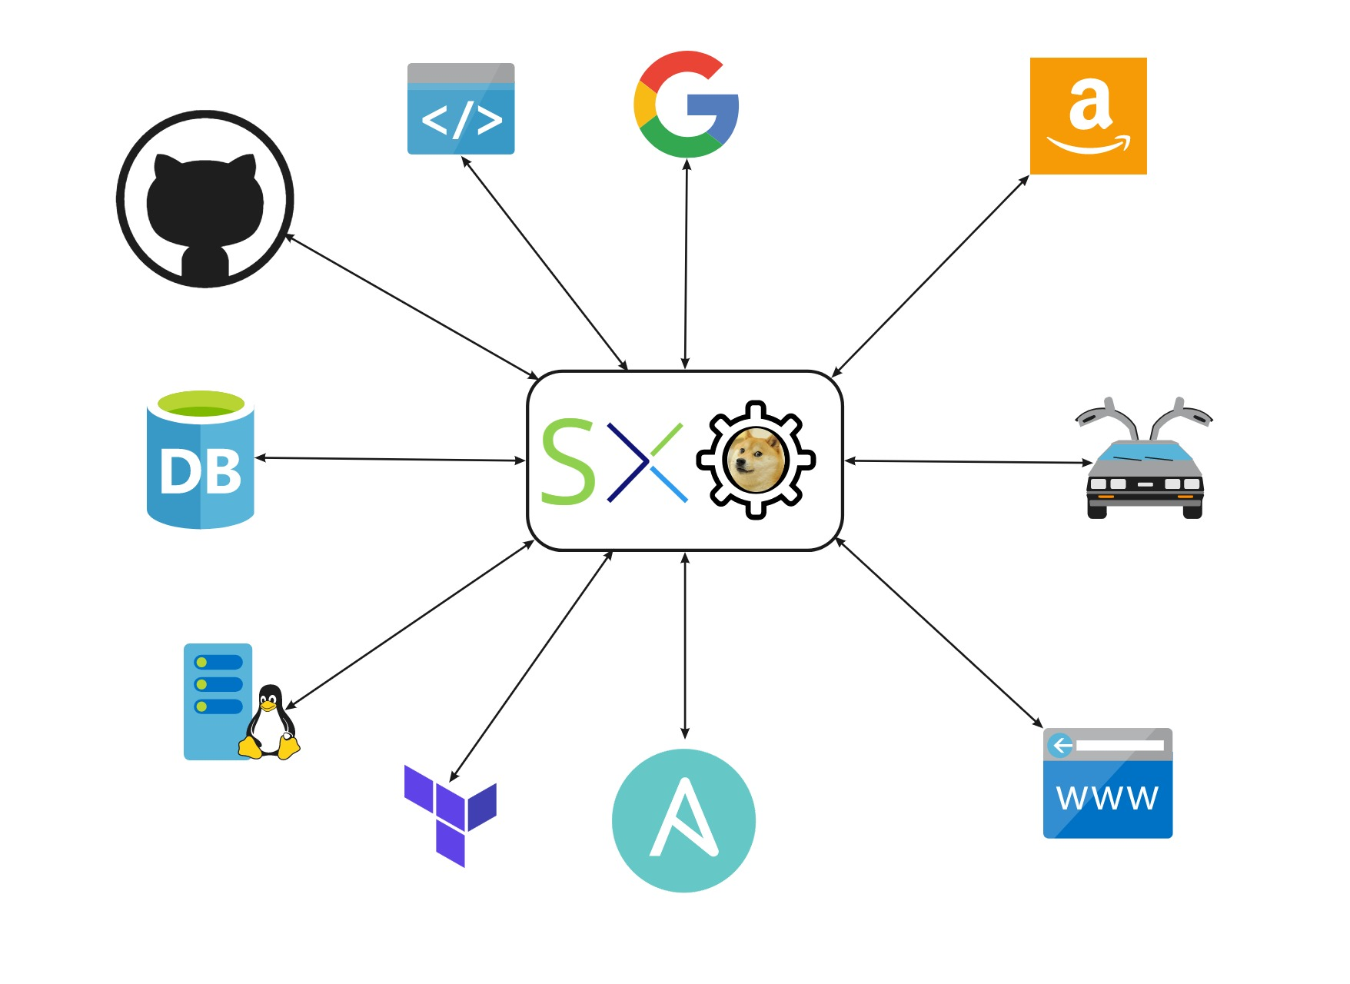
Why use SXO?
Easily Wire up inputs & outputs
SSH
REST
JDBC
Many more
Programmatic constructs
Loops
Conditions
Variables
All the usual stuff!
Graphical drag and drop ui
Accessible to everyone

Slide 11
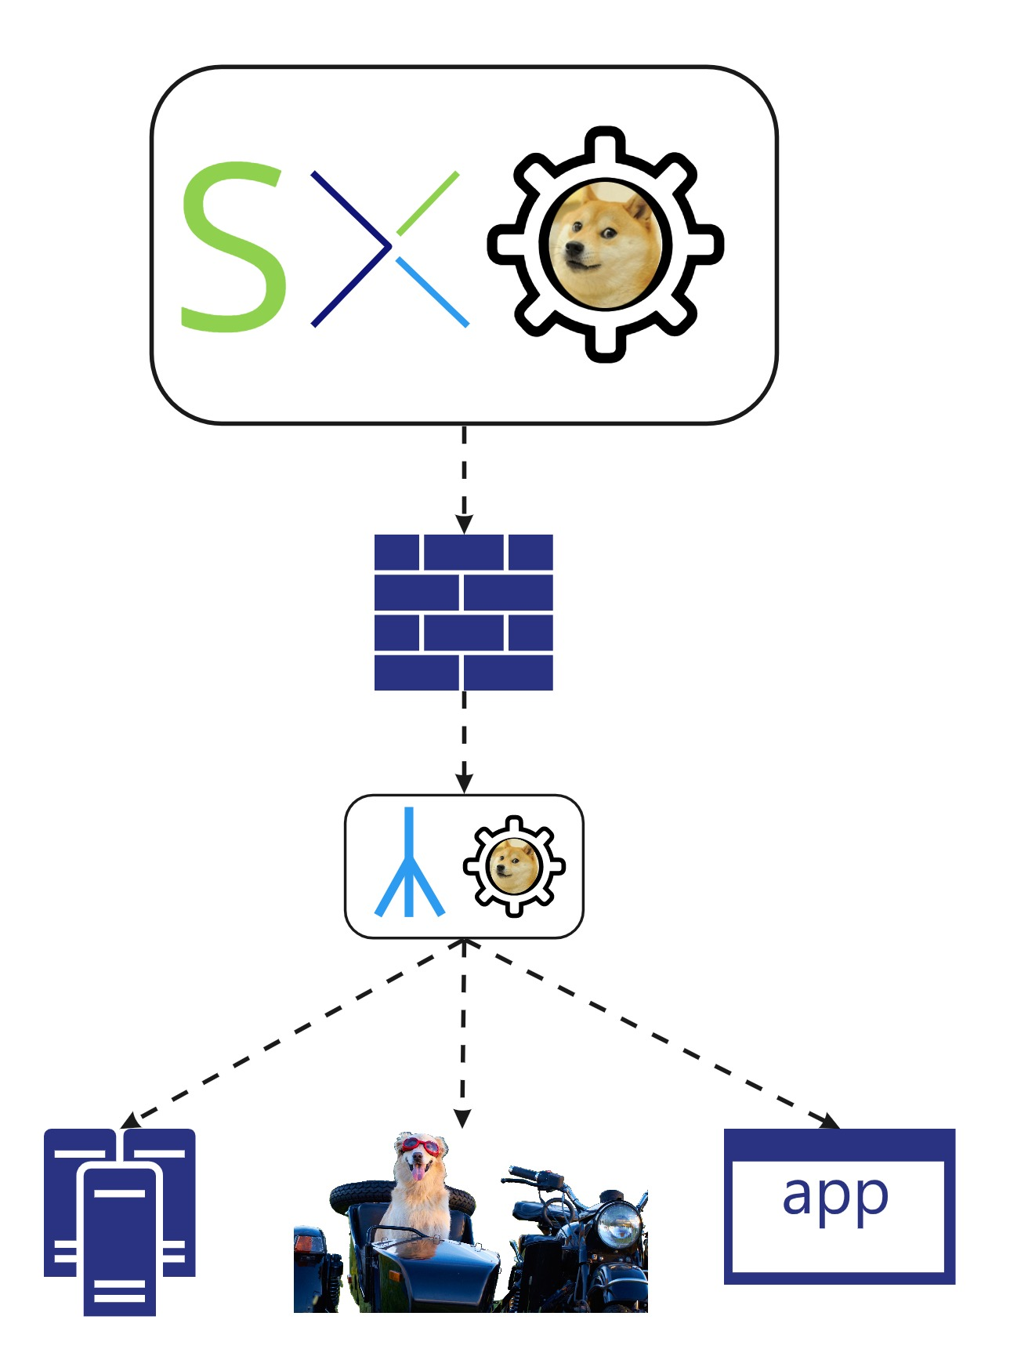
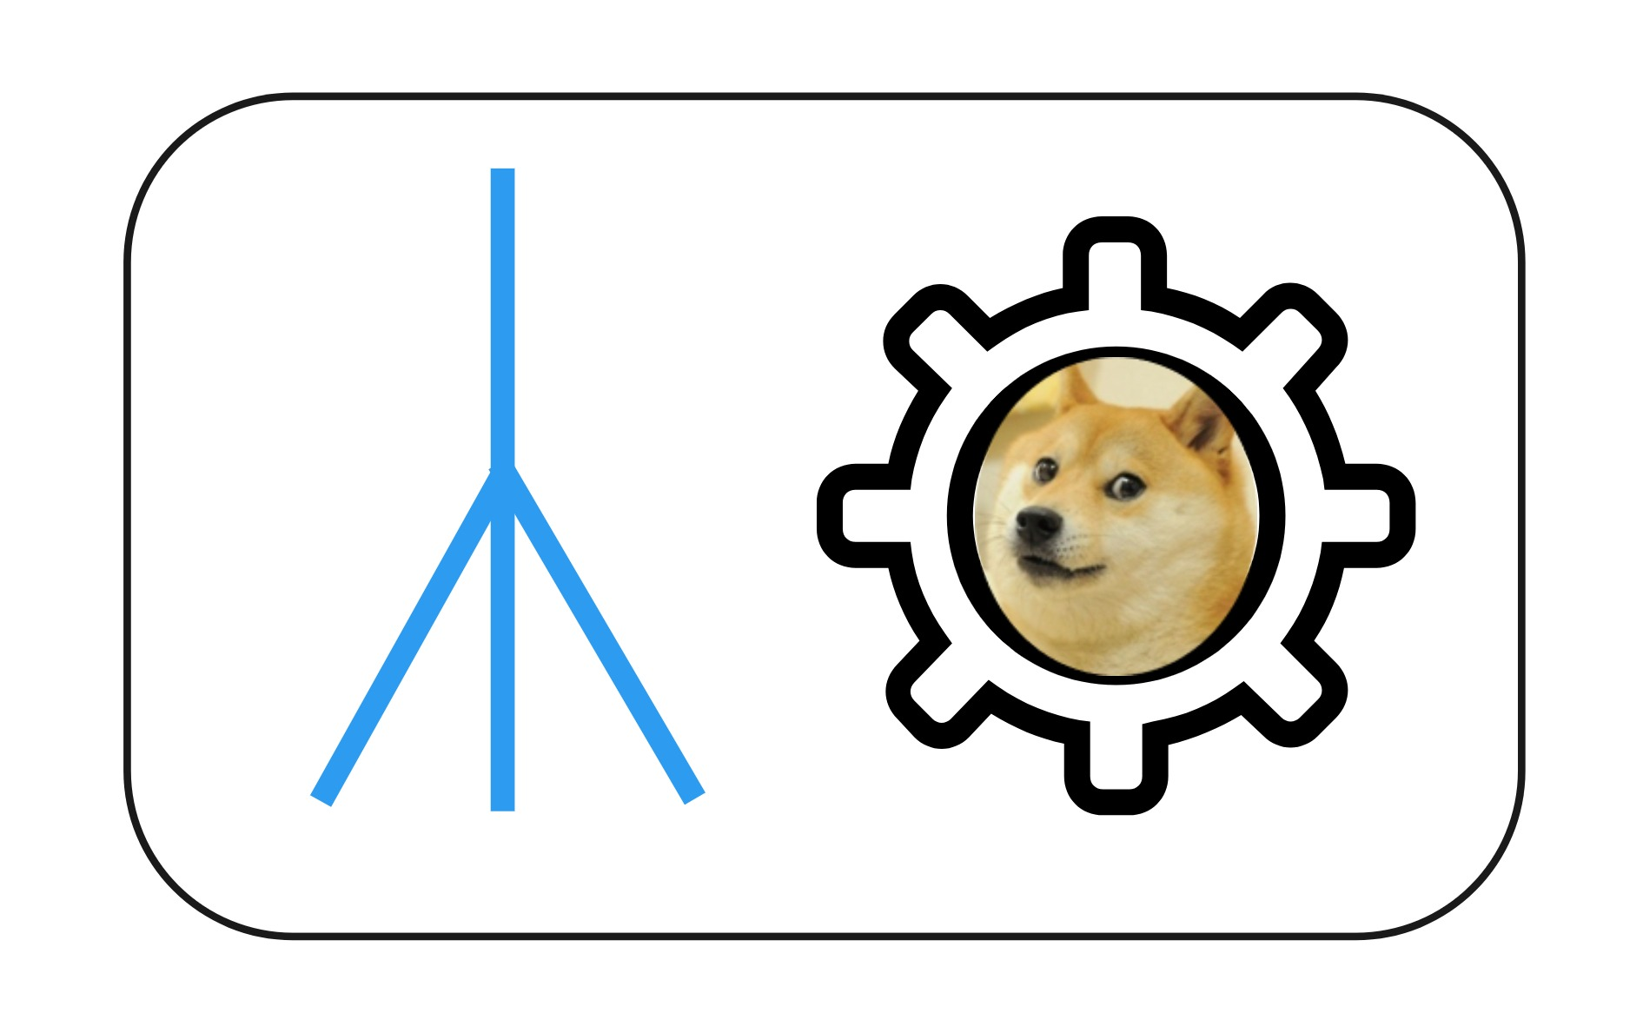
Remote Connector
Reverse proxy packaged in a Virtual Machine
Used to make calls to on-premises devices

Slide 12

What is a Sidecar
Helper Virtual machine
On same network as the target(s)
Data processing
Complex detailed tasks
Ellie

Slide 13
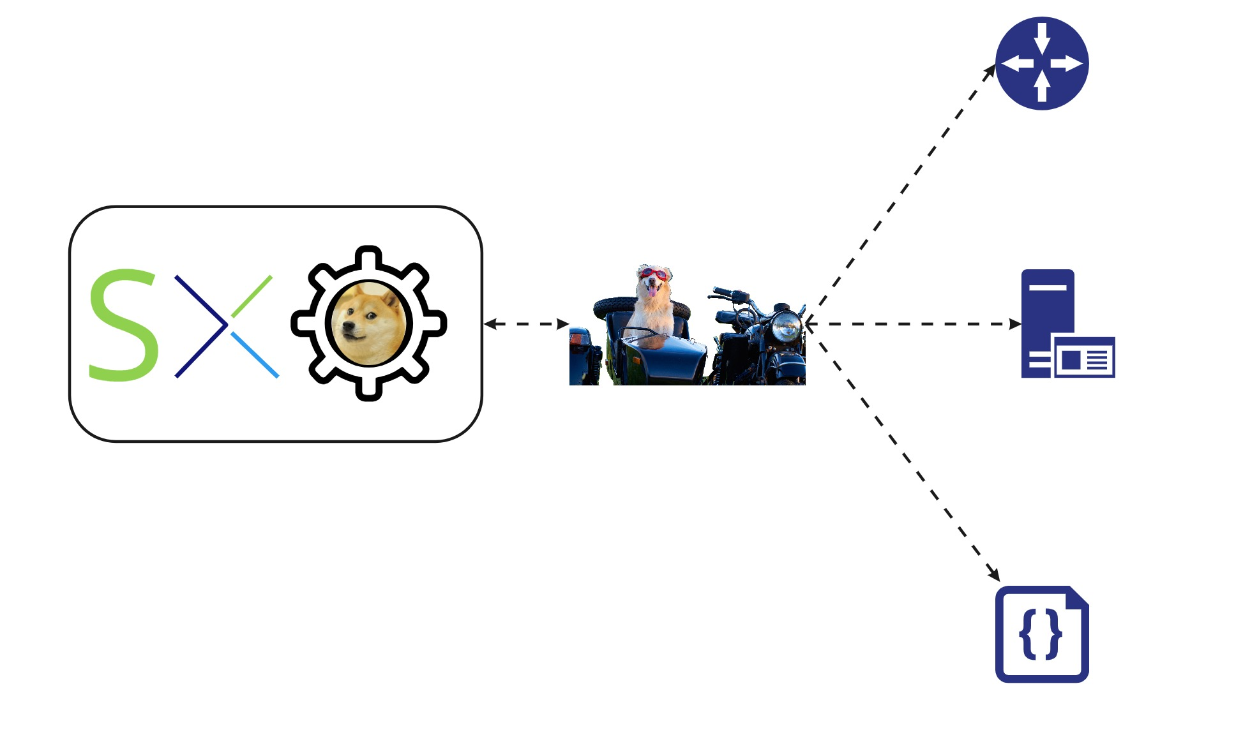
How the Sidecar Fits in
SXO calls out to sidecar
Sidecar does work
Sidecar returns result

Slide 14
Use case: Sig_XE

Slide 15
Classic branch network design
Spoke & hub w/Internet backhaul
Branch Internet traffic backhauled to datacenter.
Leverages powerful central firewalls for traffic inspection
Introduces latency
Problems in the Datacenter affect entire network
Internet
Datacenter Backhaul
Branch Routers
Hub Router

Slide 16

Solution
Reconfigure routers to use Umbrella Secure Internet Gateway (SIG)
Traffic takes optimal path to cloud provider
Datacenter issues don’t affect cloud apps
Saas-based firewalls have higher feature velocity than traditional datacenter firewalls
Jules

Slide 17
Sig_XE Implementation details

Slide 18

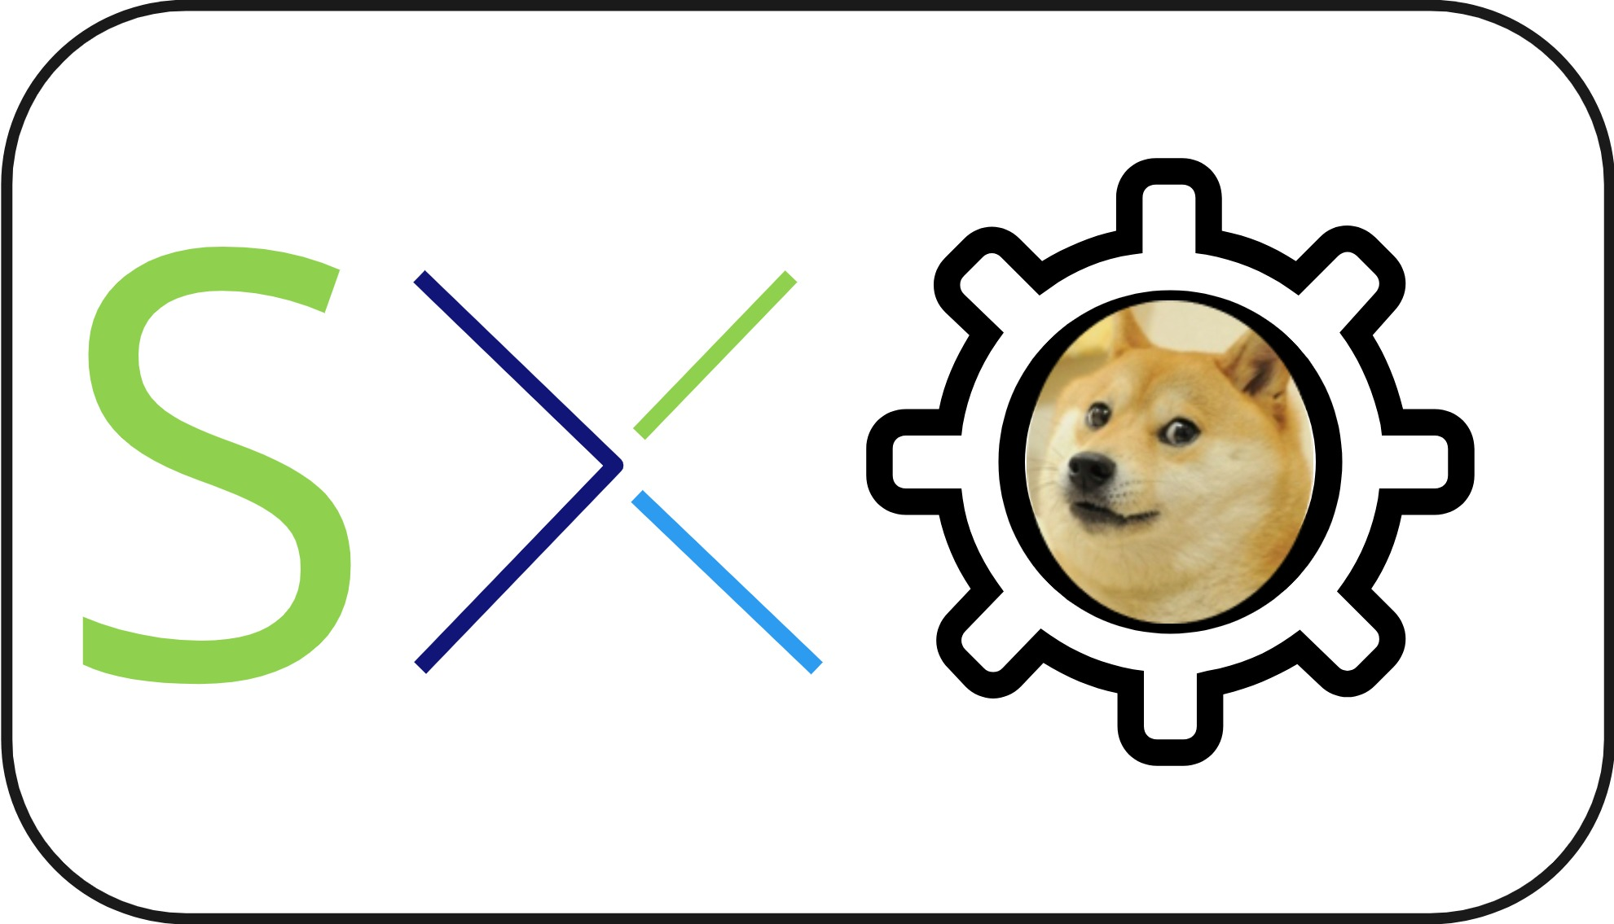


Solution Architecture
1
Load routers from DB
4
Configure Router
1
2
5
Probe for tunnel up
Provision request
3
6
Backup Path if SIG goes down
SIG Create Tunnel
Device
Inventory
2
Umbrella
Internet
3
5
Datacenter Backhaul
4
6
Branch Routers

Slide 19
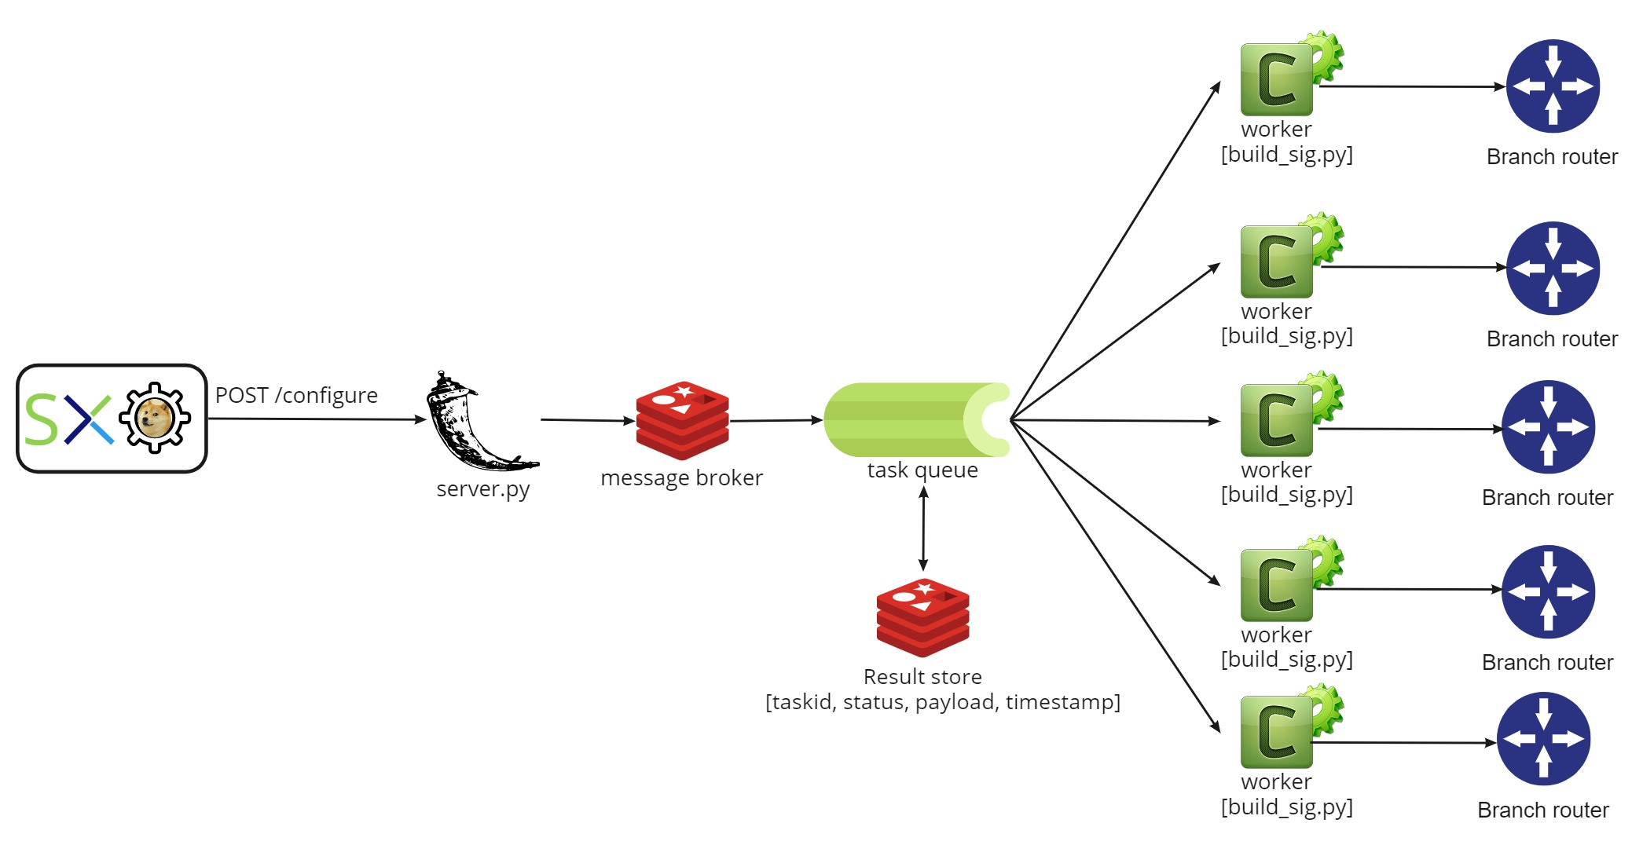
Closer look at the sidecar
Docker compose app w/3 containers
sxo_sidecar (front end)
Celery (queueing and workers)
Redis (message broker and back end)
SXO sends list of devices to the front end
Celery queues tasks, returns a task id to SXO for each router
celery workers configure routers, Umbrella tunnels
SXO polls for status until all tasks are complete

Slide 20
Demo
Sophie, Noah, Anya

Slide 21

Wrap-Up
Gidget, Mowgli

Slide 22
Summary
Use SXO for high level logic and control flow
Let SXO coordinate all the communication
Use sidecars to handle the heavy lifting
Repeatable, scalable design pattern
Example code:
https://github.com/srmcnutt/sig_xe
Pippin

Slide 23


